Slide 1


Charm++ Motivations and Basic Ideas
Laxmikant (Sanjay) Kale
http://charm.cs.illinois.edu
Parallel Programming Laboratory
Department of Computer Science
University of Illinois at Urbana Champaign

Slide 2
Challenges in Parallel Programming
Applications are getting more sophisticated
Adaptive refinements
Multi-scale, multi-module, multi-physics
E.g. load imbalance emerges as a huge problem for some apps
Exacerbated by strong scaling needs from apps
Strong scaling: run an application with same input data on more processors, and get better speedups
Weak scaling: larger datasets on more processors in the same time
Future challenge: hardware variability
Static/dynamic
Heterogeneity: processor types, process variation, ..
Power/Temperature/Energy
Component failure
To deal with these, we must seek
Not full automation
Not full burden on app-developers
But: a good division of labor between the system and app developers

Slide 3
What is Charm++?
Charm++ is a generalized approach to writing parallel programs
An alternative to the likes of MPI, UPC, GA etc.
But not to sequential languages such as C, C++, and Fortran
Represents:
The style of writing parallel programs
The runtime system
And the entire ecosystem that surrounds it
Three design principles:
Overdecomposition, Migratability, Asynchrony

Slide 4
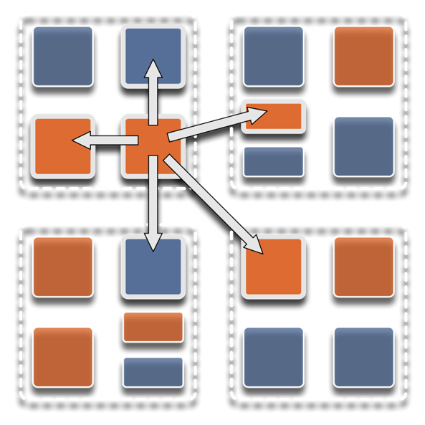
Overdecomposition
Decompose the work units & data units into many more pieces than execution units
Cores/Nodes/..
Not so hard: we do decomposition anyway

Slide 5
Different kinds of units
Migration units:
objects, migratable threads (i.e., “processes”), data sections
DEBs: units of scheduling
Dependent Execution Block
Begins execution after one or more (potentially) remote dependence is satisfied
SEBs: units of analysis
Sequential Execution Blocks
A DEB is partitioned into one or more SEBs
Has a “reasonably large” granularity, and uniformity in code structure
Loop nests, functions, …

Slide 6
Migratability
Allow these work and data units to be migratable at runtime
i.e. the programmer or runtime, can move them
Consequences for the app-developer
Communication must now be addressed to logical units with global names, not to physical processors
But this is a good thing
Consequences for RTS
Must keep track of where each unit is
Naming and location management

Slide 7
Asynchrony: Message-Driven Execution
With over decomposition and Migratibility:
You have multiple units on each processor
They address each other via logical names
Need for scheduling:
What sequence should the work units execute in?
One answer: let the programmer sequence them
Seen in current codes, e.g. some AMR frameworks
Message-driven execution:
Let the work-unit that happens to have data (“message”) available for it execute next
Let the RTS select among ready work units
Programmer should not specify what executes next, but can influence it via priorities

Slide 8
Realization of this model in Charm++
Overdecomposed entities: chares
Chares are C++ objects
With methods designated as “entry” methods
Which can be invoked asynchronously by remote chares
Chares are organized into indexed collections
Each collection may have its own indexing scheme
1D, ..7D
Sparse
Bitvector or string as an index
Chares communicate via asynchronous method invocations
A[i].foo(….); A is the name of a collection, i is the index of the particular chare.

Slide 9
Parallel Address Space
Processor 0
Processor 1
Scheduler
Scheduler
Message Queue
Message Queue
Processor 2
Processor 3
Scheduler
Scheduler
Message Queue
Message Queue

Slide 10
Message-driven Execution
A[23].foo(…)
Processor 0
Processor 1
Scheduler
Scheduler
Message Queue
Message Queue
Notes:
Certain member functions of certain classes are globally visible
Invocation of a member function may lead to communication

Slide 11
Processor 0
Processor 1
Scheduler
Scheduler
Message Queue
Message Queue
Processor 2
Processor 3
Scheduler
Scheduler
Message Queue
Message Queue

Slide 12
Processor 0
Processor 1
Scheduler
Scheduler
Message Queue
Message Queue
Processor 2
Processor 3
Scheduler
Scheduler
Message Queue
Message Queue

Slide 13
Processor 0
Processor 1
Scheduler
Scheduler
Message Queue
Message Queue
Processor 2
Processor 3
Scheduler
Scheduler
Message Queue
Message Queue

Slide 14
Empowering the RTS
Adaptive
Runtime System
Introspection
Adaptivity
Asynchrony
Overdecomposition
Migratability
The Adaptive RTS can:
Dynamically balance loads
Optimize communication:
Spread over time, async collectives
Automatic latency tolerance
Prefetch data with almost perfect predictability

Slide 15
Charm++ Benefits
Over-decomposition
Scalable Tools
Automatic overlap of Communication and Computation
Message-driven execution
Perfect prefetch
compositionality
Emulation for Performance Prediction
Migratability
Fault Tolerance
Introspective and adaptive runtime system
Dynamic load balancing (topology-aware, scalable)
Temperature/Power/Energy Optimizations

Slide 16
Charm++ Benefits
Over-decomposition
Scalable Tools
Automatic overlap of Communication and Computation
Message-driven execution
Perfect prefetch
compositionality
Emulation for Performance Prediction
Migratability
Fault Tolerance
Introspective and adaptive runtime system
Dynamic load balancing (topology-aware, scalable)
Temperature/Power/Energy Optimizations

Slide 17
Utility for Multi-cores, Many-cores, Accelerators:
Objects connote and promote locality
Message-driven execution
A strong principle of prediction for data and code use
Much stronger than principle of locality
Can use to scale memory wall:
Prefetching of needed data:
into scratch pad memories, for example
Processor 1
Scheduler
Message Queue
Notes:
Replace figure with a new drawing

Slide 18
Impact on communication
Current use of communication network:
Compute-communicate cycles in typical MPI apps
The network is used for a fraction of time
and is on the critical path
Current communication networks are over-engineered for by necessity
P1
P2
BSP based application

Slide 19
Impact on communication
With overdecomposition:
Communication is spread over an iteration
Adaptive overlap of communication and computation
P1
P2
Overdecomposition enables overlap

Slide 20
Decomposition Challenges
Current method is to decompose to processors
This has many problems
Deciding which processor does what work in detail is difficult at large scale
Decomposition should be independent of number of processors – enabled by object based decomposition
Adaptive scheduling of the objects on available resources by the RTS

Slide 21
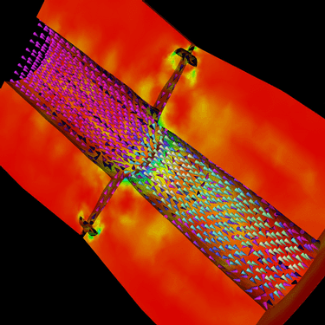
Decomposition Independent of numCores
Rocket simulation example under traditional MPI
With migratable-objects:
Benefit: load balance, communication optimizations, modularity
Solid
Solid
. . .
Solid
Fluid
Fluid
Fluid
1 2 P
Solid₁
Solid₂
Solid₃
. . .
Solid_{n}
Fluid₁
Fluid₂
. . .
Fluid_{m}
Notes:
21
In traditional MPI paradigm. The number of partitions of both modules is typically equal to the number of processor P
And although the i’th elements of fluid module and solid module are not connected geometrically in the simulation, they are glued together on the I’th processor.
Under Charm++/AMPI framework, the two modules each get their own set of parallel objects. And the size of the arrays are not restricted or related.
The benefit of this is performance optimizations and better modularity.
Problem: due to the asynchronous method invocation, the flow of control is buried deep into the object code

Slide 22
Compositionality
It is important to support parallel composition
For multi-module, multi-physics, multi-paradigm applications…
What I mean by parallel composition
B || C where B, C are independently developed modules
B is parallel module by itself, and so is C
Programmers who wrote B were unaware of C
No dependency between B and C
This is not supported well by MPI
Developers support it by breaking abstraction boundaries
E.g., wildcard recvs in module A to process messages for module B
Nor by OpenMP implementations:

Slide 23
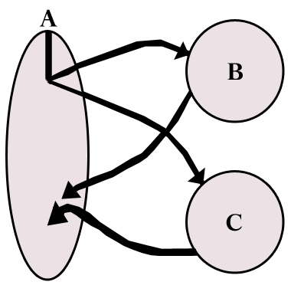
Without message-driven execution (and virtualization), you get either:
Space-division
B
C
Time
Notes:
Replace “scanned” diagram on the left with a better one, in all the slides that use this.

Slide 24
OR: Sequentialization
B
C
Time

Slide 25
Parallel Composition: A1; (B || C ); A2
Recall: Different modules, written in different languages/paradigms, can overlap in time and on processors, without programmer having to worry about this explicitly

Slide 26
So, What is Charm++?
Object Oriented Parallel Programming
Identify the entities being simulated (say atoms, routers, humans)
Define the computational tasks being performed (think force computation)
Create C++ classes to encapsulate them
Use member functions to interact
What about processors? Do you really want to worry about them?

Slide 27
So, What is Charm++?
Charm++ is a way of parallel programming based on:
Objects
Overdecomposition
Messages
Asynchrony
Migratability
Adaptive runtime system

Slide 28
Charm++ Applications as case studies
Only brief overview today

Slide 29
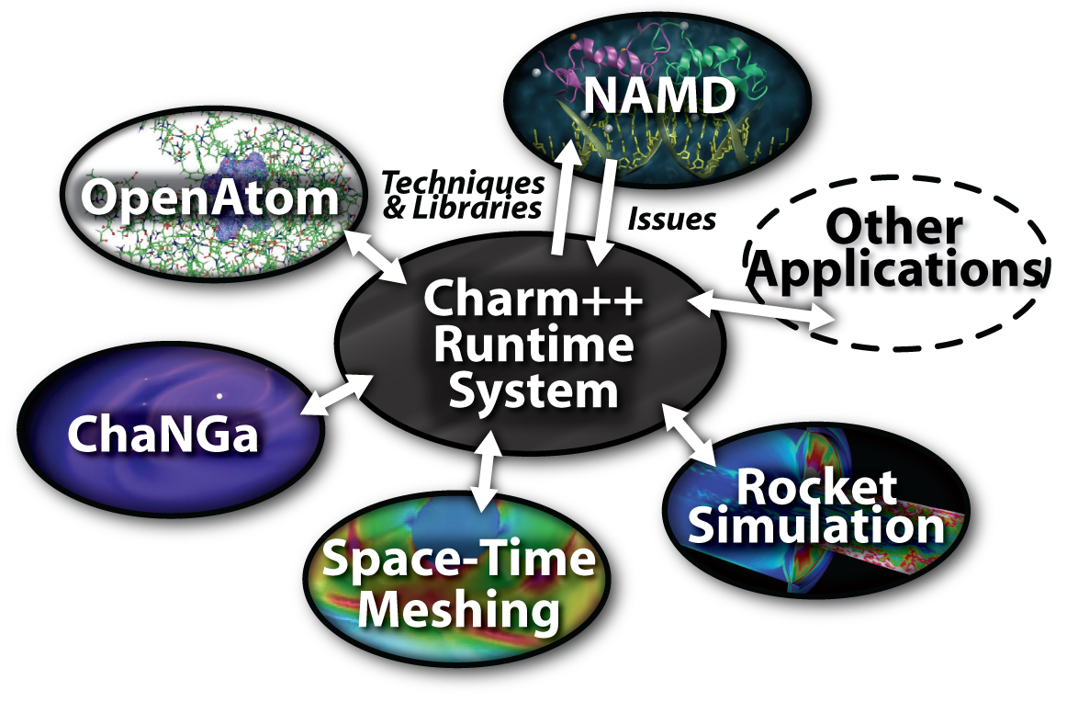
Charm++ and CSE Applications
Well-known Biophysics molecular simulations App
Gordon Bell Award, 2002
Nano-Materials..
Synergy
Enabling CS technology of parallel objects and intelligent runtime systems has led to several CSE collaborative applications
ISAM
Computational Astronomy
_{EpiSimdemics}
_{Stochastic}
_{Optimization}

Slide 30
Grainsize
Charm++ philosophy:
let the programer decompose their work and data into coarse-grained entities
It is important to understand what I mean by coarse-grained entities
You don’t write sequential programs that some system will auto-decompose
You don’t write programs when there is one object for each float
You consciously choose a grainsize, BUT choose it independent of the number of processors
Or parameterize it, so you can tune later

Slide 31
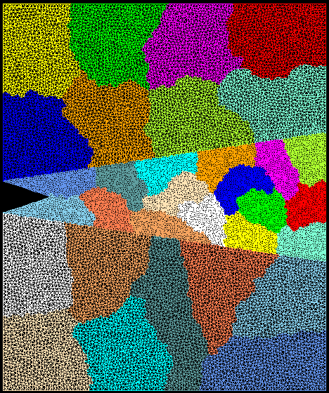
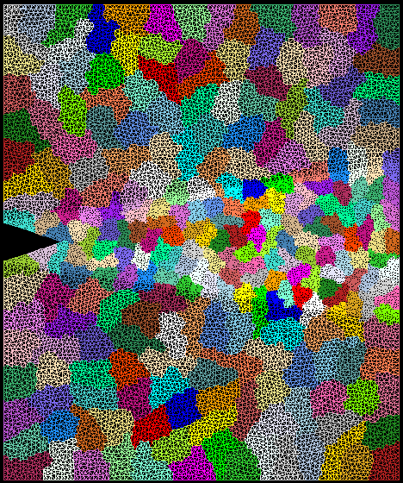
Crack Propagation
This is 2D, circa 2002…
but shows over-decomposition for unstructured meshes..
Decomposition into 16 chunks (left) and 128 chunks, 8 for each PE (right). The middle area contains cohesive elements. Both decompositions obtained using Metis. Pictures: S. Breitenfeld, and P. Geubelle

Slide 32
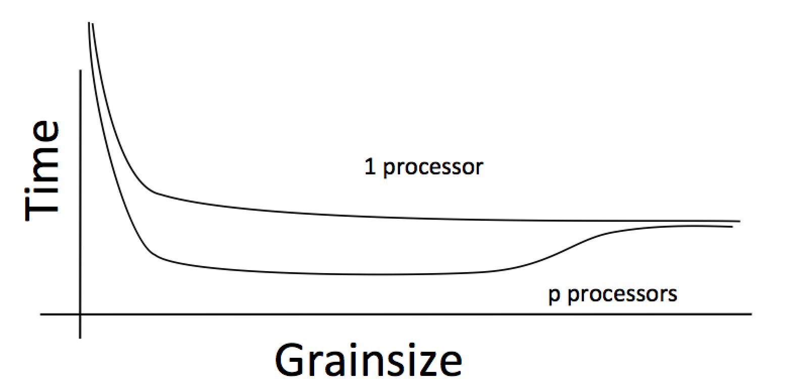
Working definition of grainsize:
amount of computation per remote interaction
Choose grainsize to be just large enough to amortize the overhead

Slide 33
Grainsize in a common setting
2 MB/chare,
256 objects per core

Slide 34
Rules of thumb for grainsize
Make it as small as possible, as long as it amortizes the overhead
More specifically, ensure:
Average grainsize is greater than kv (say 10v)
v: overhead per message, p: number of processors, T: sequential execution time
No single grain should be allowed to be too large
Must be smaller than T/p, but actually we can express it as
Must be smaller than kmv (say 100v)
Important corollary:
You can be at close to optimal grainsize without having to think about P, the number of processors
34

Slide 35
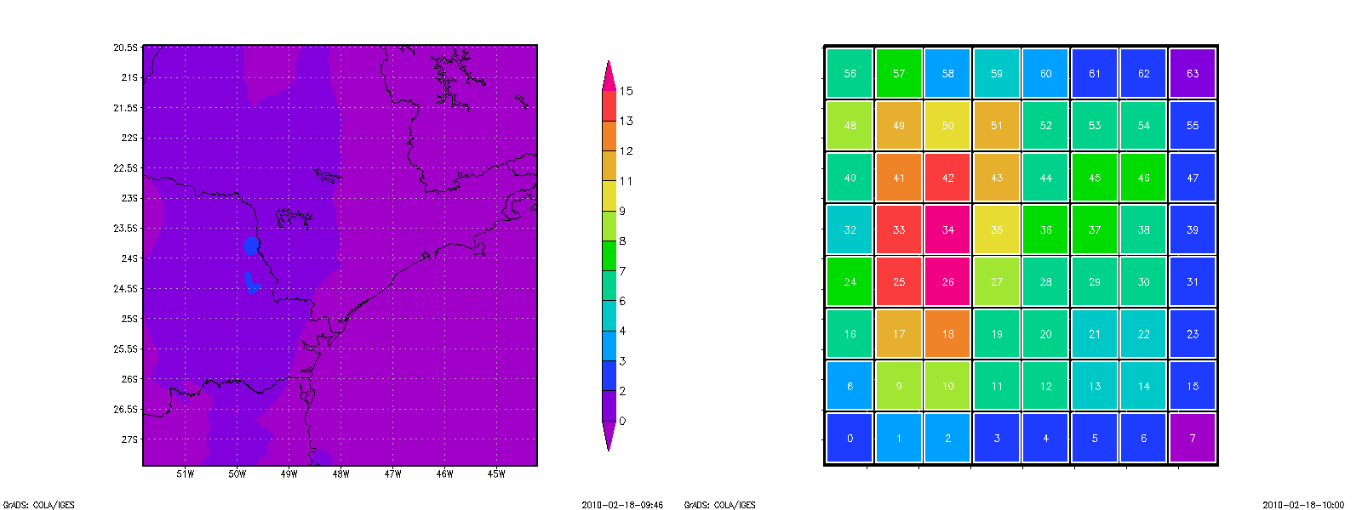

Grainsize: Weather Forecasting in BRAMS
Brams: Brazillian weather code (based on RAMS)
AMPI version (Eduardo Rodrigues, with Mendes, J. Panetta, ..)
Instead of using 64 work units on 64 cores, used 1024 on 64

Slide 36
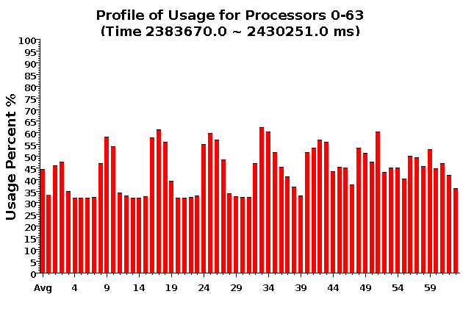
Baseline: 64 objects

Slide 37
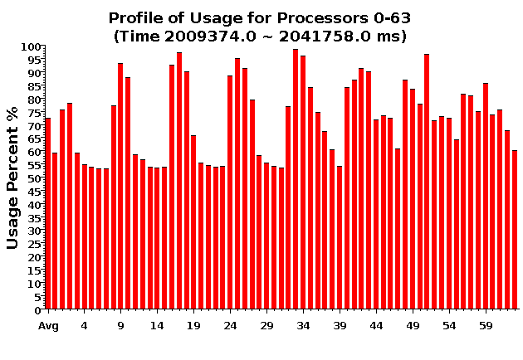
Over-decomposition: 1024 objects
Benefits from communication/computation overlap

Slide 38
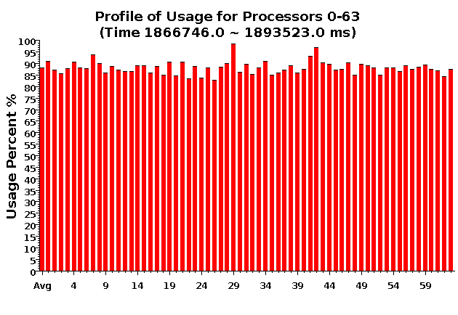
With Load Balancing: 1024 objects
No overdecomp (64 threads) | 4988 sec
Overdecomp into 1024 threads | 3713 sec
Load balancing (1024 threads) | 3367 sec

Slide 39
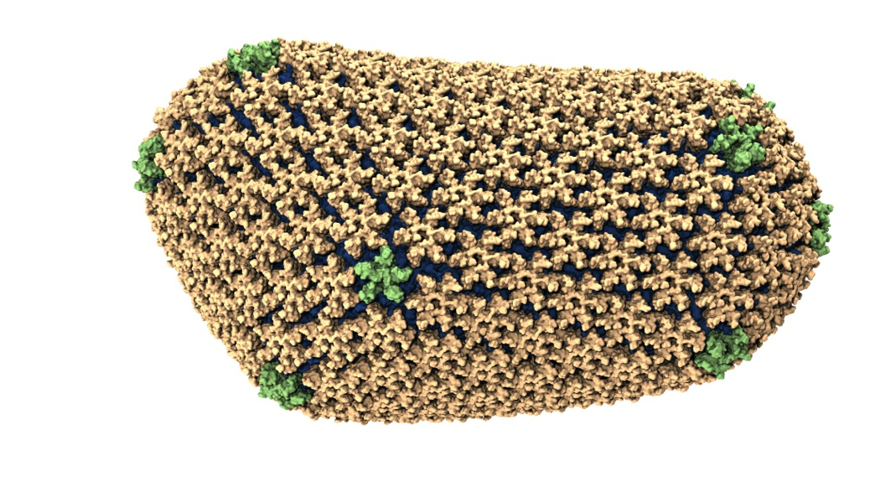
NAMD: Biomolecular Simulations
Collaboration with K. Schulten
With over 50,000 registered users
Scaled to most top US supercomputers
In production use on supercomputers and clusters and desktops
Gordon Bell award in 2002
Recent success: Determination of the structure of HIV capsid by researchers including Prof Schulten

Slide 40
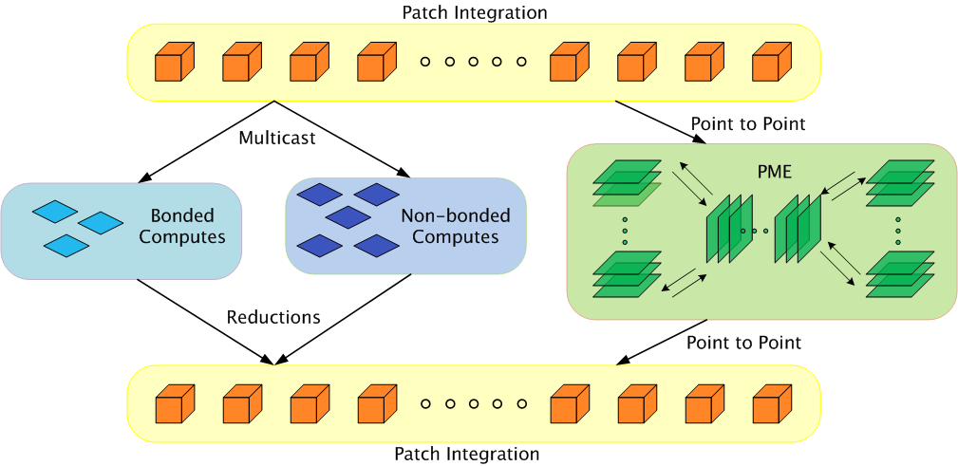
Parallelization using Charm++

Slide 41
Grainsize example: NAMD
High performing examples (objects are the work-data units in Charm++):
On Blue Waters, 100M atom simulation
128K cores (4K nodes): 5,510,202 objects
Edison, Apoa1 (92K atoms)
4K cores: 33,124 objects
Hopper, STMV (1M atoms)
15,360 cores: 430,612 objects

Slide 42
NAMD strong scaling on Titan Cray XK7, Blue Waters Cray XE6, and Mira IBM Blue Gene/Q for 21M and 224M atom benchmarks

Slide 43
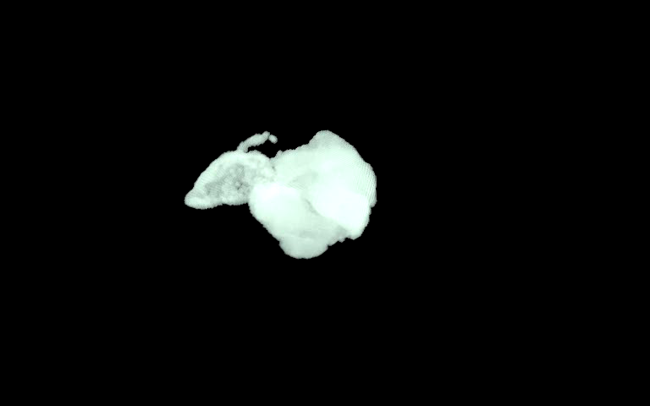
ChaNGa: Parallel Gravity
Evolution of Universe and Galaxy Formation
Collaborative project (NSF)
with Tom Quinn, Univ. of Washington
Gravity, gas dynamics
Barnes-Hut tree codes
Oct tree is natural decomp
Geometry has better aspect ratios, so you “open” up fewer nodes
But is not used because it leads to bad load balance
Assumption: one-to-one map between sub-trees and PEs
Binary trees are considered better load balanced
With Charm++: Use Oct-Tree, and let Charm++ map subtrees to processors

Slide 44
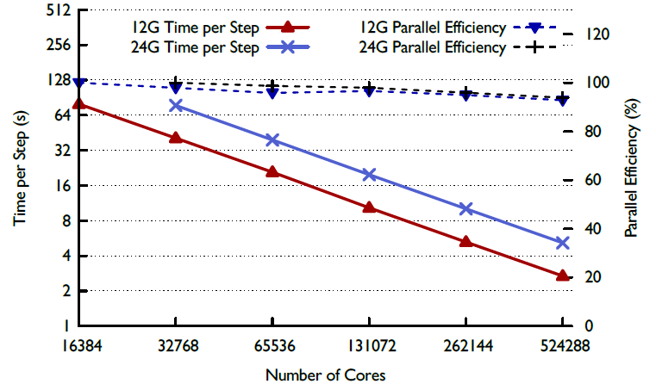
ChaNGa : a recent result

Slide 45
Episimdemics
Simulation of spread of contagion
Code by Madhav Marathe, Keith Bisset, .. Vtech
Original was in MPI
Converted to Charm++
Benefits: asynchronous reductions improved performance considerably

Slide 48
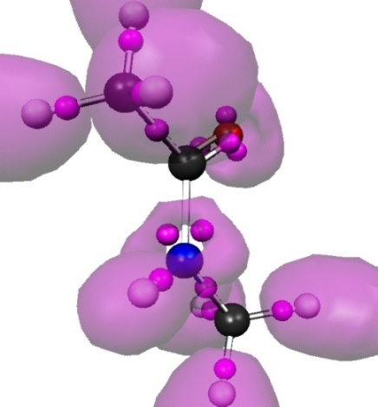
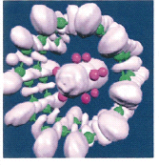
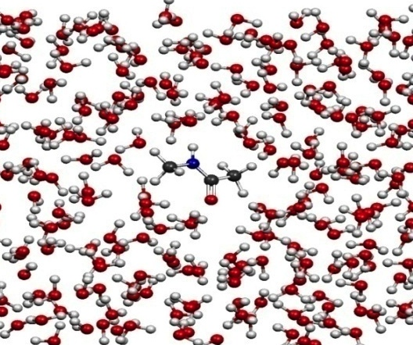
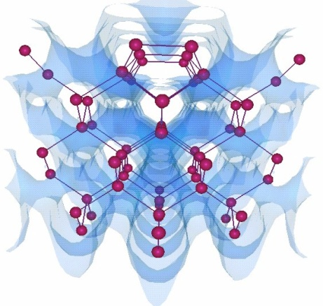
OpenAtom
Car-Parinello Molecular Dynamics
NSF ITR 2001-2007, IBM, DOE,NSF
Molecular Clusters :
Nanowires:
Recent NSF SSI-SI2 grant
With
G. Martyna (IBM)
Sohrab Ismail-Beigi
Semiconductor Surfaces:
3D-Solids/Liquids:
Using Charm++ virtualization, we can efficiently scale small (32 molecule) systems to thousands of processors

Slide 49
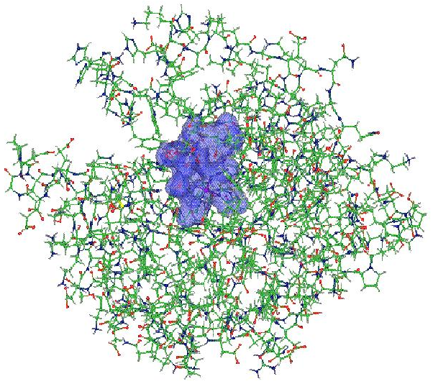
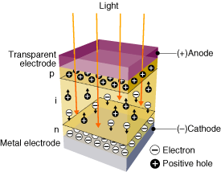
OpenAtom: On the fly ab initio molecular dynamics on the ground state surface with instantaneous GW-BSE level spectra
PIs: G.J. Martyna, IBM; S. Ismail-Beigi, Yale; L. Kale, UIUC;
Team: Q. Li, IBM, M. Kim, Yale; S. Mandal, Yale;
E. Bohm, UIUC; N. Jain, UIUC; M. Robson, UIUC; E. Mikida, UIUC; P. Jindal, UIUC; T. Wicky, UIUC.
Light in
1

Slide 50
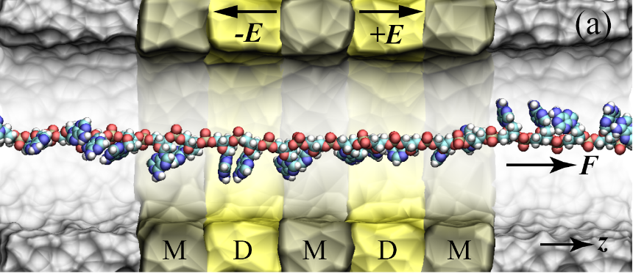

Goal : The accurate treatment of complex heterogeneous
systems to gain physical insight.
Light in
7

Slide 51
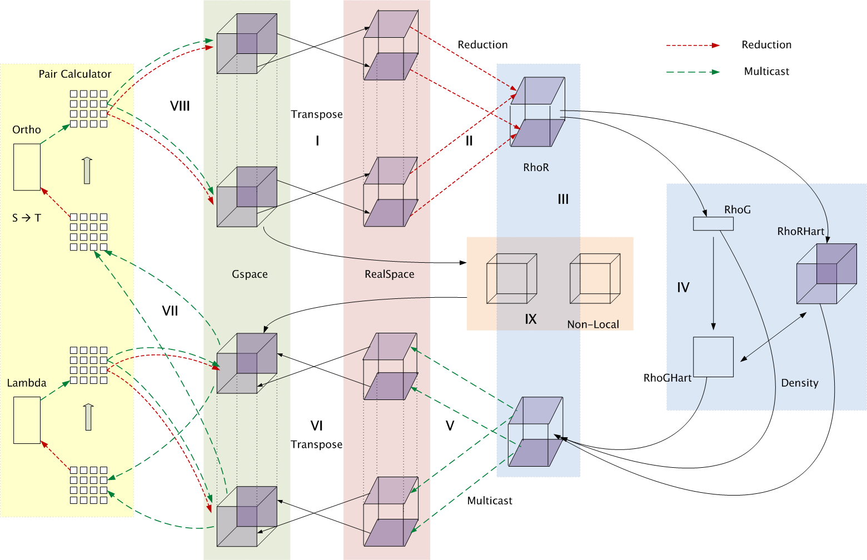
Decomposition and Computation Flow

Slide 52
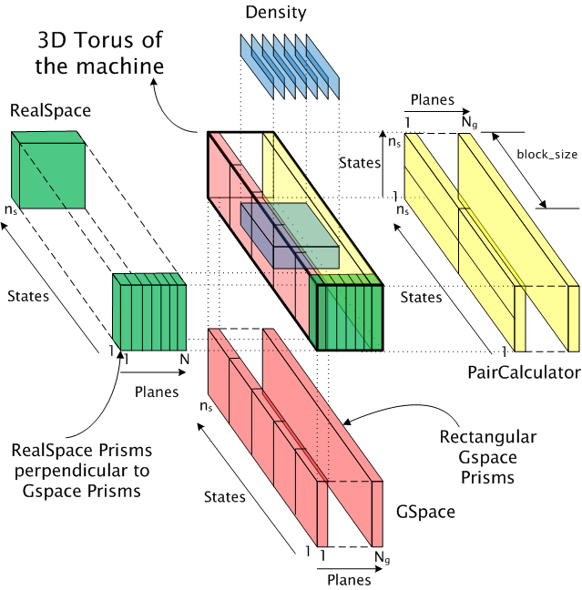
Topology Aware Mapping of Objects

Slide 53
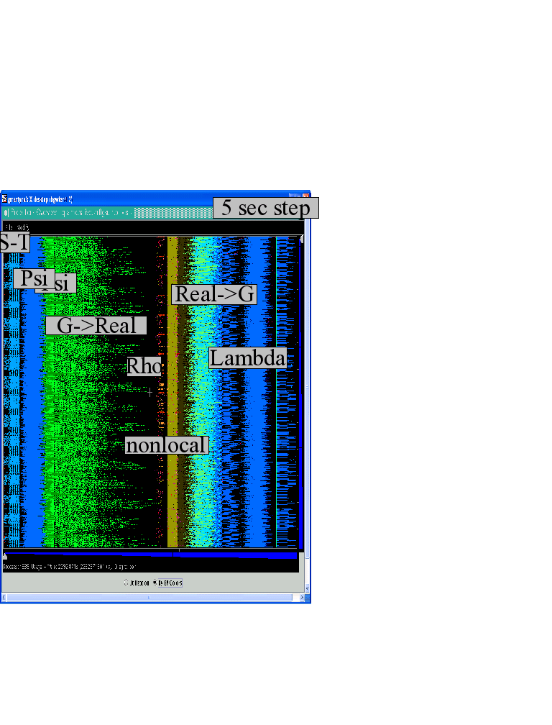
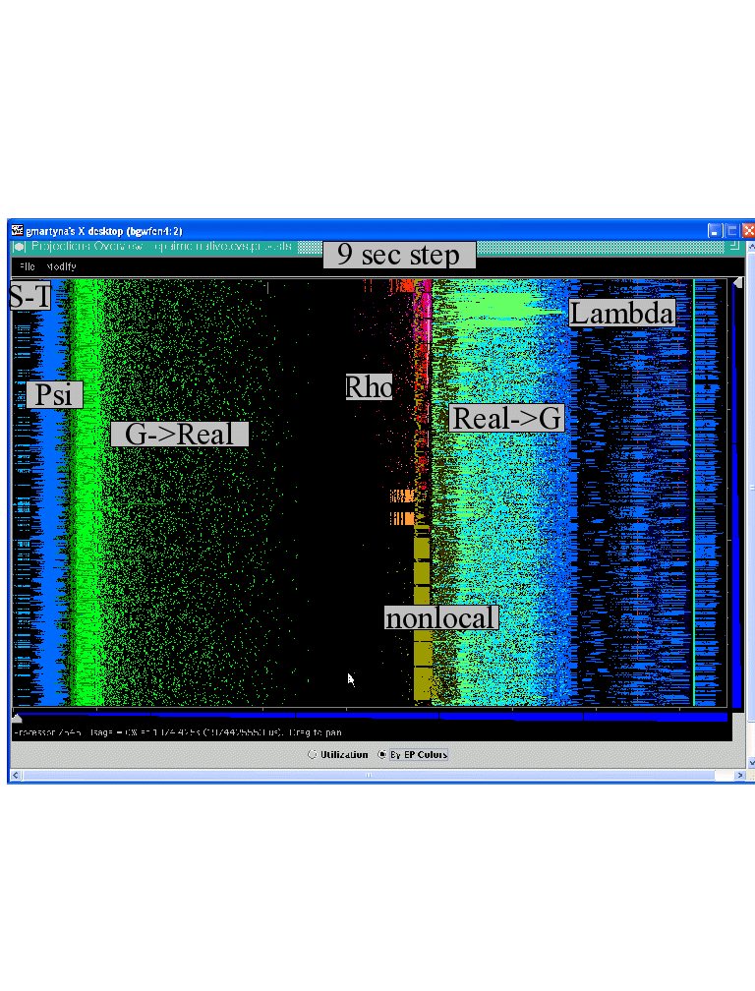

Improvements by topological aware mapping of computation to processors
Punchline: Overdecomposition into Migratable Objects created the degree of freedom needed for flexible mapping
The simulation of the left panel, maps computational work to processors taking the network connectivity into account while the right panel simulation does not. The “black’’ or idle time processors spent waiting for computational work to arrive on processors is significantly reduced at left. (256waters, 70R, on BG/L 4096 cores)

Slide 54
OpenAtom Performance Sampler
Ongoing work on:
K-points

Slide 55
Impact of mapping on Blue Waters: up to 32% improvement

Slide 56
MiniApps
Available at: http://charmplusplus.org/miniApps/
Mini-App | Features | Machine | Max cores
AMR | Overdecomposition, Custom array index, Message priorities, Load Balancing, Checkpoint restart | BG/Q | 131,072
LeanMD | Overdecomposition, Load Balancing, Checkpoint restart, Power awareness | BG/P BG/Q | 131,072 32,768
Barnes-Hut (n-body) | Overdecomposition, Message priorities, Load Balancing | Blue Waters | 16,384
LULESH 2.02 | AMPI, Over-decomposition, Load Balancing | Hopper | 8,000
PDES | Overdecomposition, Message priorities, TRAM | Stampede | 4,096

Slide 57
More MiniApps
Mini-App | Features | Machine | Max cores
1D FFT | Interoperable with MPI | BG/P BG/Q | 65,536 16,384
Random Access | TRAM | BG/P BG/Q | 131,072 16,384
Dense LU | SDAG | XT5 | 8,192
Sparse Triangular Solver | SDAG | BG/P | 512
GTC | SDAG | BG/Q | 1,024
SPH |  | Blue Waters | -

Slide 58
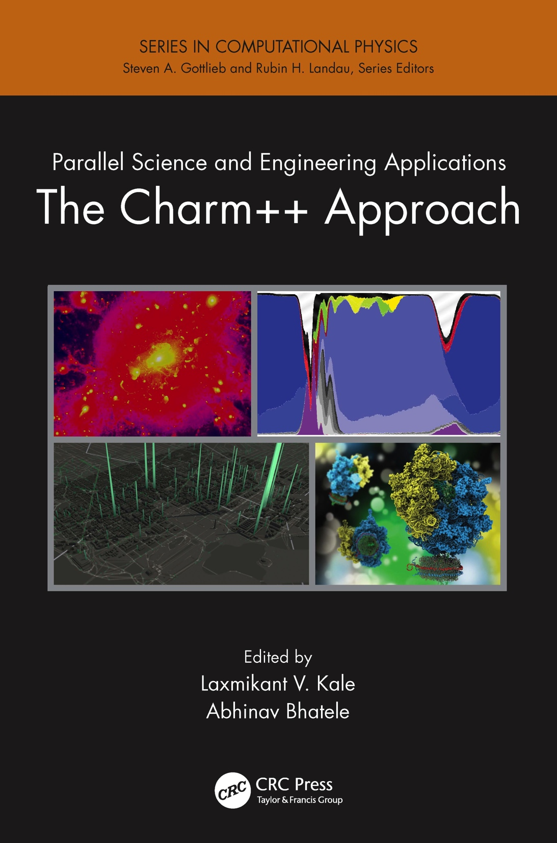
A recently published book
surveys seven major applications developed using Charm++
More info on Charm++:
http://charm.cs.illinois.edu
Including the miniApps

Slide 59
Where are Exascale Issues?
I didn’t bring up exascale at all so far..
Overdecomposition, migratability, asynchrony were needed on yesterday’s machines too
And the app community has been using them
But:
On *some* of the applications, and maybe without a common general-purpose RTS
The same concepts help at exascale
Not just help, they are necessary, and adequate
As long as the RTS capabilities are improved
We have to apply overdecomposition to all (most) apps

Slide 60
Relevance to Exascale
Intelligent, introspective, Adaptive Runtime Systems, developed for handling application’s dynamic variability, already have features that can deal with challenges posed by exascale hardware

Slide 61
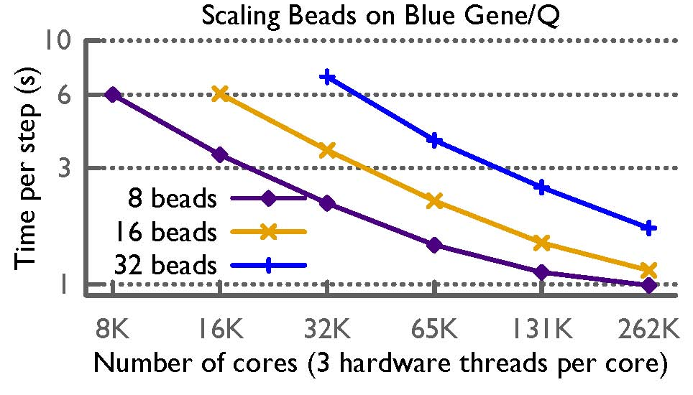
Path Integral Performance

Slide 62
Fault Tolerance in Charm++/AMPI
Four approaches available:
Disk-based checkpoint/restart
In-memory double checkpoint w auto. restart
Proactive object migration
Message-logging: scalable fault tolerance
Common Features:
Easy checkpoint: migrate-to-disk
Based on dynamic runtime capabilities
Use of object-migration
Can be used in concert with load-balancing schemes
Notes:
62

Slide 63
Power
Power consumption is continuous
Normal Checkpoint-Resart method
Progress
Progress is slowed down with failures
Time

Slide 64
Power consumption is lower during recovery
Message logging + Object-based virtualization
Progress is faster with failures

Slide 65
Saving Cooling Energy
Easy: increase A/C setting
But: some cores may get too hot
So, reduce frequency if temperature is high (DVFS)
Independently for each chip
But, this creates a load imbalance!
No problem, we can handle that:
Migrate objects away from the slowed-down processors
Balance load using an existing strategy
Strategies take speed of processors into account
Implemented in experimental version
SC 2011 paper, IEEE TC paper
Several new power/energy-related strategies
PASA ‘12: Exploiting differential sensitivities of code segments to frequency change

Slide 66
PARM:Power Aware Resource Manager
Charm++ RTS facilitates malleable jobs
PARM can improve throughput under a fixed power budget using:
overprovisioning (adding more nodes than conventional data center)
RAPL (capping power consumption of nodes)
Job malleability and moldability

Slide 67
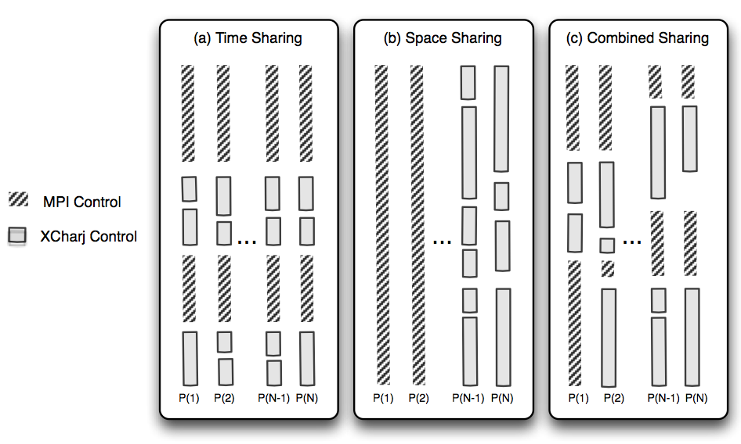
Charm++ interoperates with MPI
Charm++ Control

Slide 68
Summary
Charm++ embodies an adaptive, introspective runtime system
Many applications have been developed using it
NAMD, ChaNGa, Episimdemics, OpenAtom, …
Many miniApps, and third-party apps
Adaptivity developed for apps is useful for addressing exascale challenges
Resilience, power/temperature optimizations, ..
More Info: http://charm.cs.illinois.edu/ (including the miniApps)
Overdecomposition
Asynchrony
Migratability

Slide 69
Hello World Example
hello.ci file
mainmodule hello {
mainchare Main {
entry Main(CkArgMsg ∗m);
};
};
hello.cpp file
#include <stdio.h>
#include ”hello.decl.h”
class Main : public CBase_Main {
public: Main(CkArgMsg∗ m) {
ckout << “Hello World!” << endl;
CkExit();
};
};
#include “hello.def.h”

Slide 70
Hello World Example
Compiling
charmc hello.ci
charmc -c hello.C
charmc -o hello hello.o
Running
./charmrun +p7 ./hello
The +p7 tells the system to use seven cores

